Slide 1
Work plan

Slide 2
Dataset
Batch - indicator number for each campaign | Melt Output (MT) – given
Heat number – no of each heat in a campaign | Input energy (KWH) – given
Total heating time (minutes) – given | Voltage –given
Scrap (MT) – given | Frequency –given
Sponge (MT) – calculated | Melt rate (MT/hr) – calculated
Hot Heel (MT) – given | Efficiency (MT/KWH) – calculated
Alloys (MT) – given | Refractory lining – start and end given
Input (MT) – calculated | Rating of the furnace (KW) - given
Final C% - given
Tapping Temperature - given

Slide 3
Data description
Inputs : Charge mix (sponge, alloys, hot heel and scrap/pig iron), refractory lining at start
Outputs : Output molten metal, slag, voltage, refractory lining at end of heat (data not given, value calculated by interpolation between start and end based on number of heats), time of heat, energy consumed, Tapping temperature, final C (%)
Control variable : only charge (up to what extent)

Slide 4
Efficiency
Furnace efficiency : Considers heat loss and energy loss due to various factors; compares power consumed to theoretical requirement.
Melt efficiency : Considers the efficiency of the melting process, dependent on input/output and power consumed.
Yield : Output/Input (I doubt the need of this as input is calculated using output by us and the relationship is known).

Slide 5
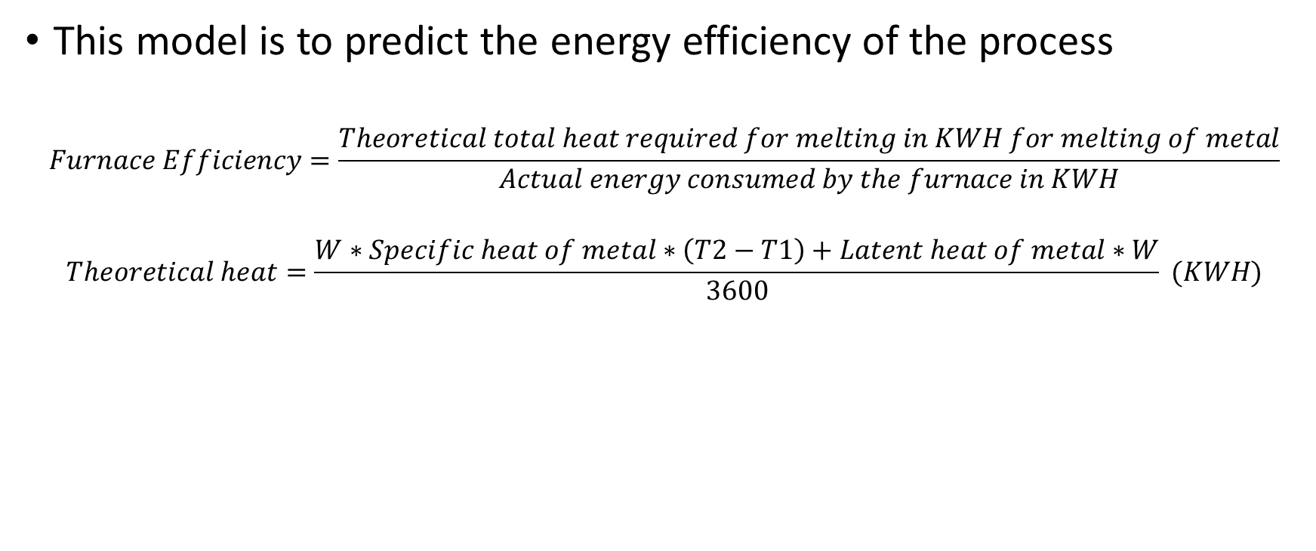
Model 1 - Furnace efficiency
This model is to predict the energy efficiency of the process
$$Furnace Efficiency=\frac{Theoretical total heat required for melting in KWH for melting of metal}{Actual energy consumed by the furnace in KWH}$$
$$Theoretical heat=\frac{W∗Specific heat of metal∗\left(T2−T1\right)+Latent heat of metal∗W}{3600} (KWH)$$

Slide 6
Model 2 – Melt efficiency
This model considers the efficiency of melting process with respect to power consumed
Melt efficiency = Input charged per heat/Energy consumed per heat

Slide 7
Model 1 and 2 description – for each heat/melt
1. Furnace
Efficiency – can compute power consumed from this
2. Melt efficiency – power from this as well
3. Heat time
4. Voltage t1
5. Frequency t1
Charge-scrap, sponge, hot heel, alloys (t1)
Voltage t0
Frequency t0
Rating of furnace t0
Lining thickness t1
Tapping temp t1
Black box
Multi-linear regression model
Note : The voltage change due to capacitor removal effect needs to be accounted for

Slide 8
Model 3 – Refractory lining prediction, batch wise aggregate
Refractory thickness start
Refractory thickness end
Frequency start
Frequency end
Voltage start
Voltage end
Total charge input
Tapping temperature
Furnace capacity
1. Number of heats
2. Average furnace efficiency
3. Average melt efficiency
Black box

Slide 9
Data needed from SGRI
What can be the range of input material (MT) for a furnace with a given capacity?
Capacity and dimensions of the furnace
More information on how many capacitors are available and how many can be removed
What are the various parameters that they look for before deciding on how much amount of material they can charge?
What type of steel is needed as the output?

Slide 10
Refractory lining at the end of heat is a predicted variable
Refractory lining prediction: For each campaign, take initial and final thickness and interpolate linearly to get thickness of each heat
After seeing the performance of linear interpolation model, try other interpolation techniques (second phase)
Voltage change after capacitor gets removed (previous heat and next heat discontinuity needs to be addressed)
Keep the data points where capacitor is getting removed separate for reference

Slide 11
Modelling the effects of removing a capacitor
Try to predict voltage at the end of the heat, and based on this suggest when to remove a capacitor for optimal performance
Inputs are voltage before, frequency before, lining thickness before, number of capacitors before and after

Slide 12
Dataset preparation
If the data for number of capacitors removed is missing, then it is assumed that no capacitors are removed for that heat
Last heat (with 0 melt-rate) is removed
First heat is not included in the analysis
Refractory lining data is interpolated linearly
The average thickness of top, middle, and bottom is taken as the lining thickness

Slide 13
Linear Models

Slide 14
All Inputs and Target is Efficiency
Target Variable | Input | Weight of Input
Efficiency | Scrap (MT) | 0.2037
 | Sponge (MT) | 0.2907
Metrics | Alloys (MT) | -0.0537
Train NMSE: 81.015 | Previous Voltage | -0.0048
Test NMSE: 153.271 | Previous Frequency | -0.0002
R2: -0.532 | Previous Rating of the Furnace | -0.0048
 | Refractory lining before heating | 0.0269
 | Number of capacitors removed | 0.0105
 | Tapping Temperature | 0.0241

Slide 15
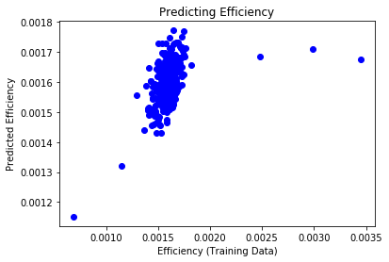
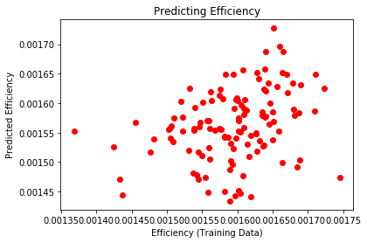
All Inputs and Target is Efficiency

Slide 16
All Inputs and Target is Total Heat Time
Target Variable | Input | Weight of Input
Total Heat Time | Scrap (MT) | 0.1681
 | Sponge (MT) | 0.2370
Metrics | Alloys (MT) | 0.0609
Train NMSE: 90.111 | Previous Voltage | 0.0166
Test NMSE: 75.721 | Previous Frequency | 0.0154
R2: 0.242 | Previous Rating of the Furnace | 0.0166
 | Refractory lining before heating | -0.0792
 | Number of capacitors removed | -0.0476
 | Tapping Temperature | 0.0782

Slide 17
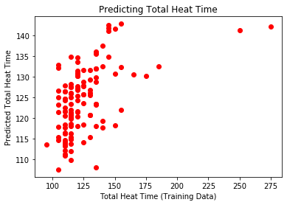
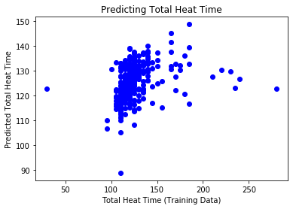
All Inputs and Target is Total Heat Time

Slide 18
All Inputs and Target is Voltage
Target Variable | Input | Weight of Input
Voltage | Scrap (MT) | -0.1701
 | Sponge (MT) | -0.1529
Metrics | Alloys (MT) | -0.0673
Train NMSE: 20.502 | Previous Voltage | 0.3255
Test NMSE: 15.240 | Previous Frequency | -0.1885
R2: 0.847 | Previous Rating of the Furnace | 0.3255
 | Refractory lining before heating | 0.2396
 | Number of capacitors removed | 0.2159
 | Tapping Temperature | -0.0599

Slide 19
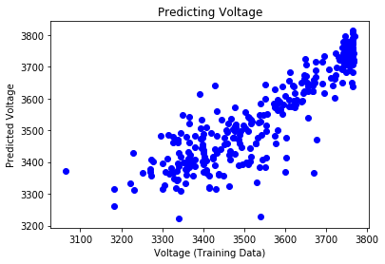
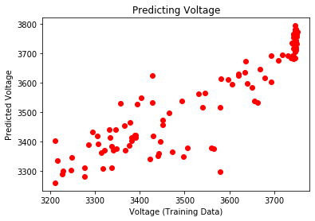
All Inputs and Target is Voltage

Slide 20
All Inputs and Target is Frequency
Target Variable | Input | Weight of Input
Frequency | Scrap (MT) | 0.2527
 | Sponge (MT) | 0.2787
Metrics | Alloys (MT) | 0.0331
Train NMSE: 3.117 | Previous Voltage | -0.0144
Test NMSE: 4.140 | Previous Frequency | 0.3635
R2: 0.958 | Previous Rating of the Furnace | -0.0144
 | Refractory lining before heating | -0.0789
 | Number of capacitors removed | 0.4047
 | Tapping Temperature | -0.0273

Slide 21
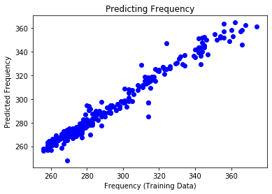
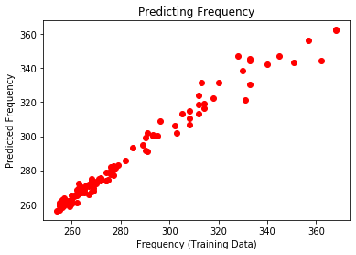
All Inputs and Target is Frequency

Slide 22
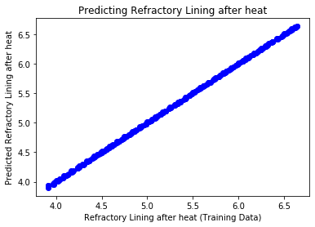
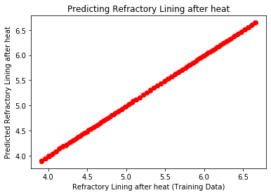
All Inputs and Target is Refractory Lining after heat

Slide 23
Non-linear Models

Slide 24
All Inputs and Target is Efficiency
Target Variable | Input
Efficiency | Scrap (MT)
 | Sponge (MT)
 | Alloys (MT)
 | Input energy previous (KWH)
Metrics | Total Heat Time previous (minutes)
Train NMSE: 9.187 | Previous Voltage
Test NMSE: 225.540 | Previous Frequency
R2: -1.255 | Previous Rating of the Furnace
 | Refractory lining before heating
 | Number of capacitors removed
 | Tapping Temperature

Slide 25
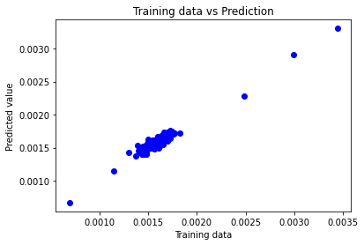
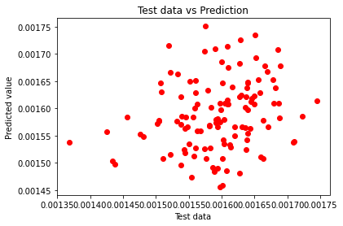
All Inputs and Target is Efficiency

Slide 26
All Inputs and Target is Total Heat Time
Target Variable | Input
Total Heat Time | Scrap (MT)
 | Sponge (MT)
 | Alloys (MT)
 | Input energy previous (KWH)
Metrics | Total Heat Time previous (minutes)
Train NMSE: 8.324 | Previous Voltage
Test NMSE: 179.659 | Previous Frequency
R2: -0.796 | Previous Rating of the Furnace
 | Refractory lining before heating
 | Number of capacitors removed
 | Tapping Temperature

Slide 27
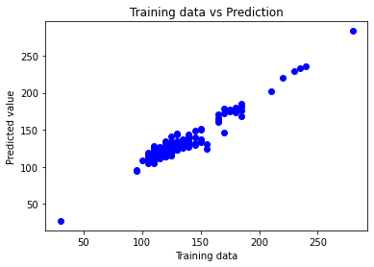
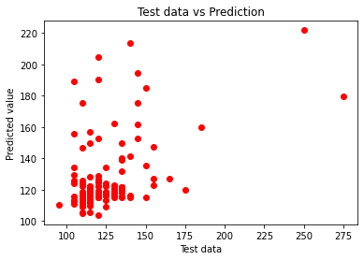
All Inputs and Target is Total Heat Time

Slide 28
All Inputs and Target is Voltage
Target Variable | Input
Voltage | Scrap (MT)
 | Sponge (MT)
 | Alloys (MT)
 | Input energy previous (KWH)
Metrics | Total Heat Time previous (minutes)
Train NMSE: 1.418 | Previous Voltage
Test NMSE: 20.815 | Previous Frequency
R2: 0.791 | Previous Rating of the Furnace
 | Refractory lining before heating
 | Number of capacitors removed
 | Tapping Temperature

Slide 29
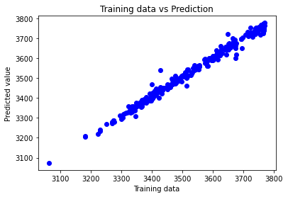
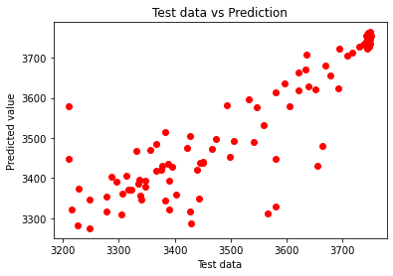
All Inputs and Target is Voltage

Slide 30
All Inputs and Target is Frequency
Target Variable | Input
Frequency | Scrap (MT)
 | Sponge (MT)
 | Alloys (MT)
 | Input energy previous (KWH)
Metrics | Total Heat Time previous (minutes)
Train NMSE: 0.438 | Previous Voltage
Test NMSE: 2.661 | Previous Frequency
R2: 0.973 | Previous Rating of the Furnace
 | Refractory lining before heating
 | Number of capacitors removed
 | Tapping Temperature

Slide 31
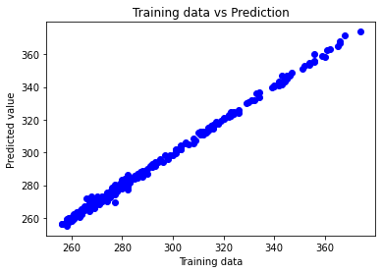
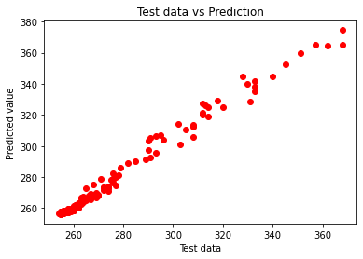
All Inputs and Target is Frequency

Slide 32
All Inputs and Target is Refractory lining after heat
Target Variable | Input
Refractory lining after heat | Scrap (MT)
 | Sponge (MT)
 | Alloys (MT)
 | Input energy previous (KWH)
Metrics | Total Heat Time previous (minutes)
Train NMSE: 0.183 | Previous Voltage
Test NMSE: 0.508 | Previous Frequency
R2: 0.994 | Previous Rating of the Furnace
 | Refractory lining before heating
 | Number of capacitors removed
 | Tapping Temperature

Slide 33
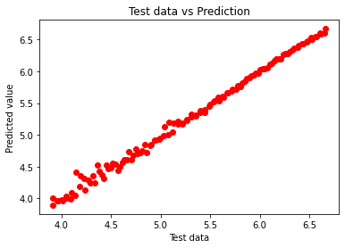
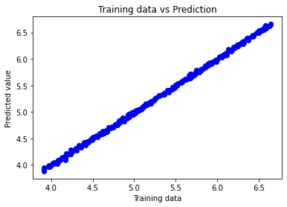
All Inputs and Target is Refractory lining after heat

